Slide 1
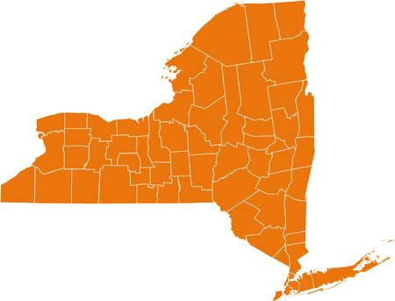
New York State Gender Ratio Prediction
Aastha Agrawal 01
Abhijeet Katiyar 02
Shivaansh Agarwal 24
Mentor:
Ankit Dwivedi Sir
Notes:
Good Afternoon all of you.
So today we going to present before you our Findings and Analysis regarding the New York State Demographic Data.

Slide 2
Contents:
Understanding The Business Perspective
Project Overview
Exploratory Data Analysis & Data Cleaning
Why Multiple Regression?
Assumptions regarding Multiple Regression
Model Building & Evaluation
Questions
Conclusions
Language Used: R
Packages Used: psych, caTools, ggplot2, car
Notes:
This is the list of topics which we’re going to cover during our presentation.

Slide 3




Understanding
the Business
Perspective
Notes:
So, Government Organizations and private companies in order to make good policies, do research, marketing or environmental and human development often use the demographics data,
which is collected by the census organizations which maybe either private or government.
For example in areas where the percentage of elderly people is more than children and middle aged people government may be interested in investing in setting-up more medical care facilities rather than setting up more schools or industries.

Slide 4
Project Overview (New York State Demographics Dataset)

Slide 5
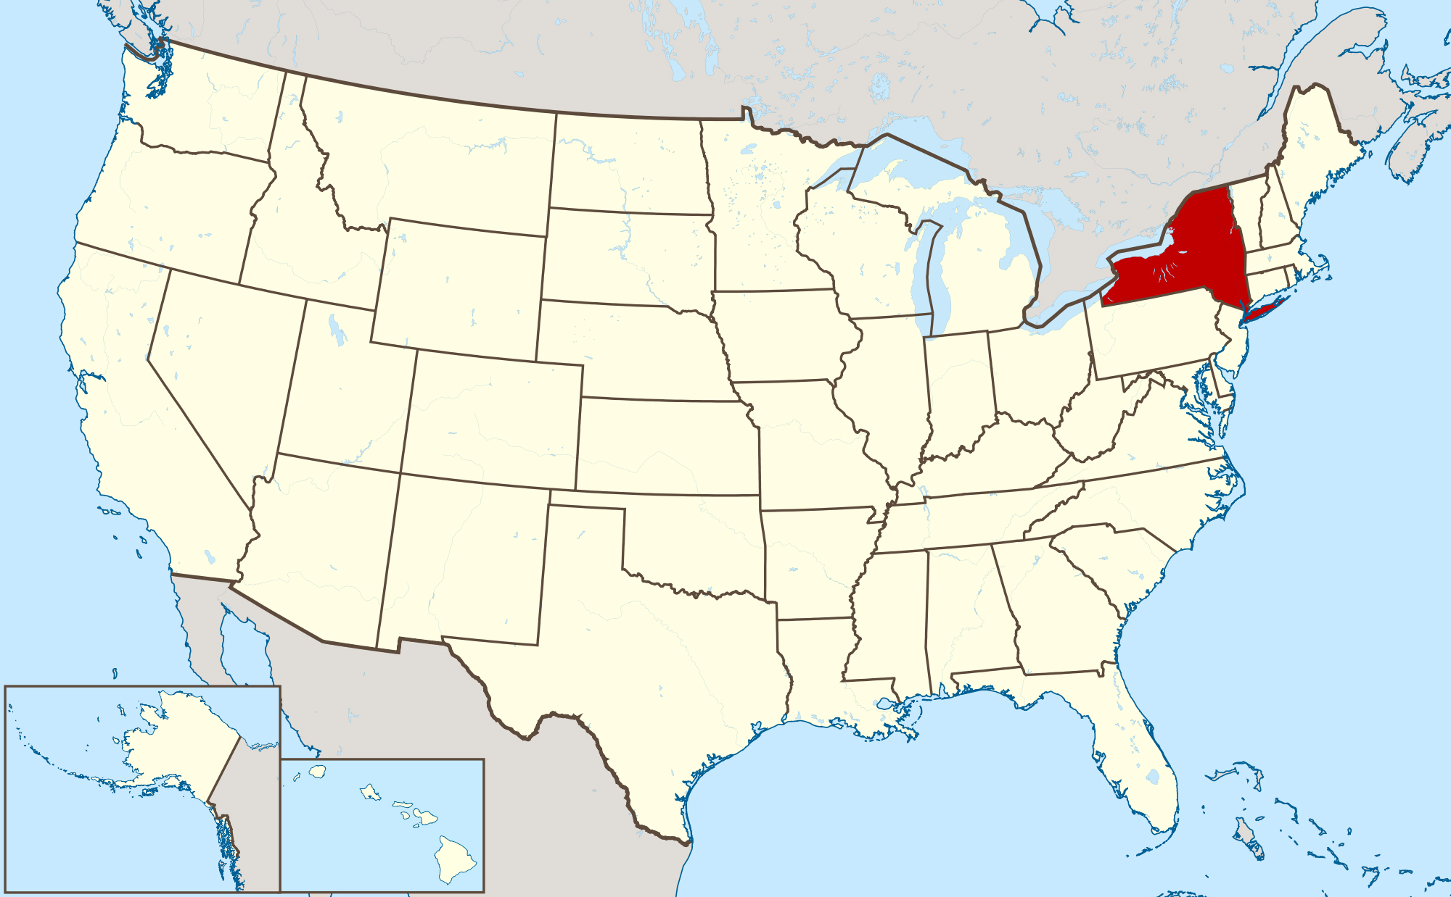
Map of USA highlighting the New York State
Notes:
So similarly, in this project we were also given the Demographics Dataset of The New York State.

Slide 6
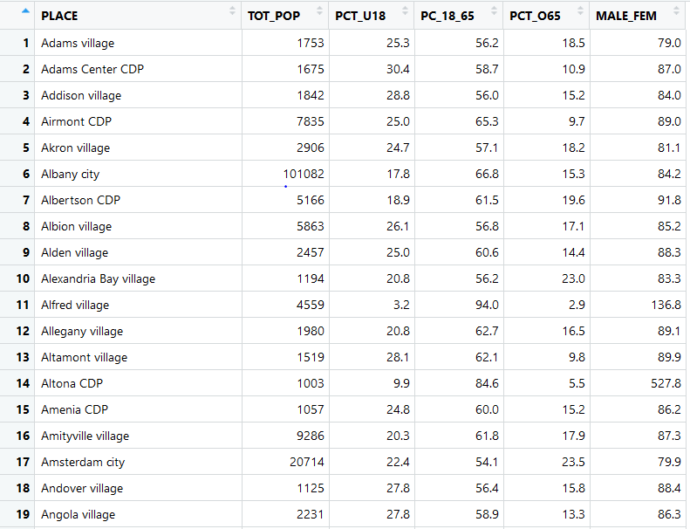
Notes:
This is the snapshot of the dataset which we got.
Since we didn’t knew what is the source of the data i.e from where has this data been generated
we decided to crosscheck whether the data is correct and when this dataset was created.
So after doing some research over the Internet we came to know that the Data is of the 1990 census.
So as we can see the dataset consists of 6 columns:

Slide 7
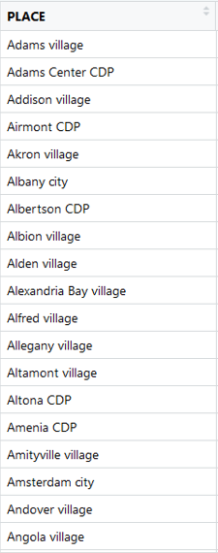
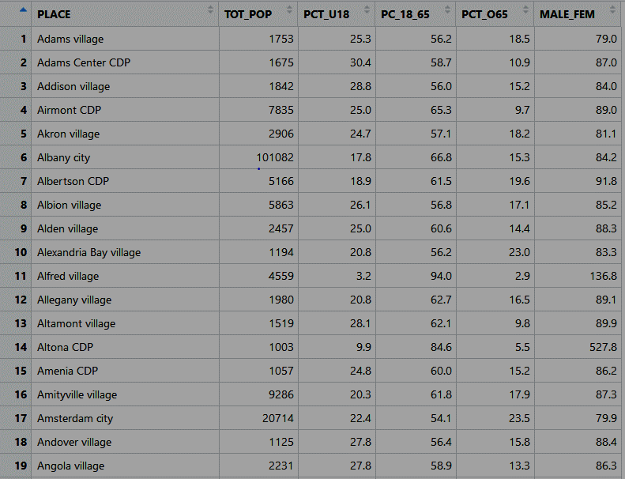
Notes:
PLACE: This column contains the different regions in the New York state.

Slide 8

Notes:
TOT_POP: This column contains the total populations of their respective regions.

Slide 9

Notes:
PCT_U18: This column contains the percentage of people which are below 18 years of age.

Slide 10

Notes:
PC_18_65: This column contains the percentage of people which are between 18 and 65 years of age.

Slide 11
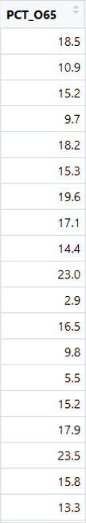
Notes:
PCT_O65: This column contains the percentage of people which are above 65 years of age.

Slide 12
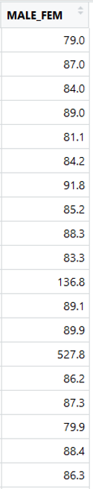
Notes:
MALE_FEM: This column contains the ratio of number of males per 100 females in the region.
Now our task was to predict using Multiple Regression the MALE to FEM ratio.

Slide 13

Notes:
So just like us some of you might also be having the question like just by knowing your age group how can I tell whether you’re a male or female.
So keeping that question aside we bagan our analysis:

Slide 14
Exploratory
Data Analysis

Slide 15


Count of NA Values and Empty Strings in The Dataset

Slide 16
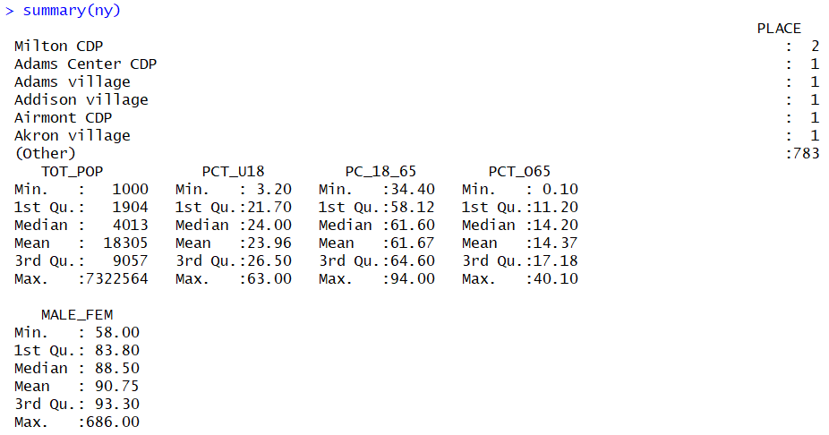
Summary Statistics of the Dataset
Notes:
After using the summary function over our dataset we found that
The first column i.e. the PLACE is a categorical variable with all values unique.
In the send column we got the minimum value as 1000 but maximum was around 73 lakhs but median only 4013.
Although that value was very high but after doing some backtracking we came to know that the value was not wrong.
But for our dataset these types of values were outliers.
Why did you remove those values when they were correct?
-> Because they were creating bias in our model.
What is bias?
-> Bias are the simplifying assumptions made by a model to make the target function easier to learn.
What are outliers?
Similarly in the other columns also we found some outliers.

Slide 17
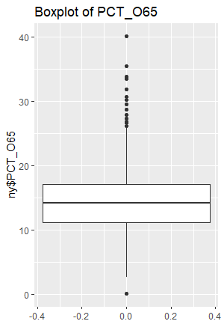
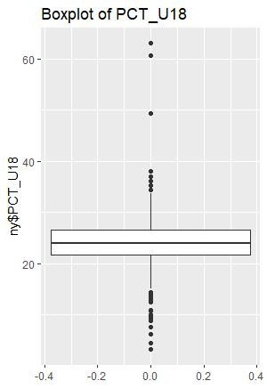
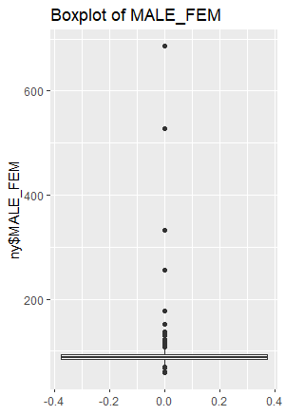
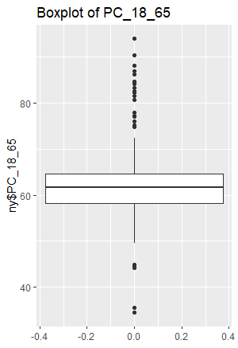
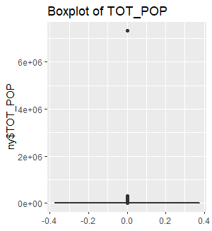
Boxplots of Different Variables in the Dataset

Slide 18
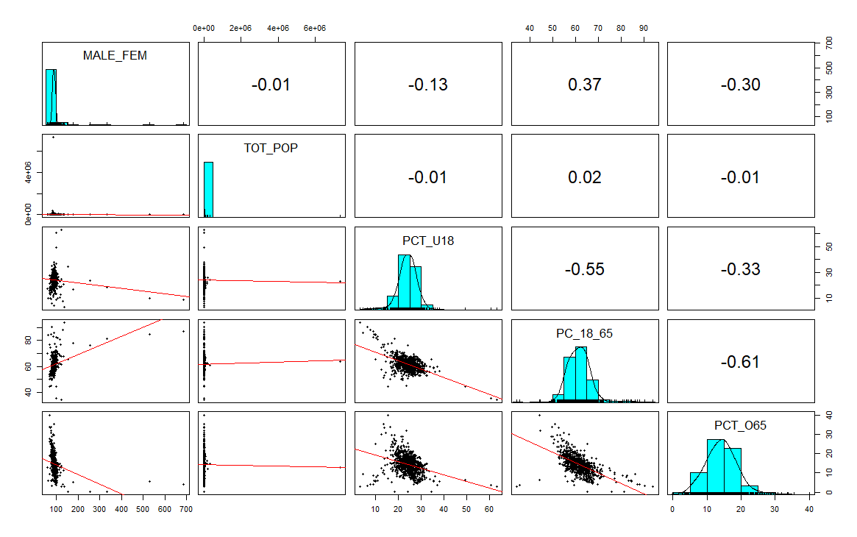
Combination of Scatterplot Matrix, Histograms, Correlation Matrix before Data Cleaning

Slide 19
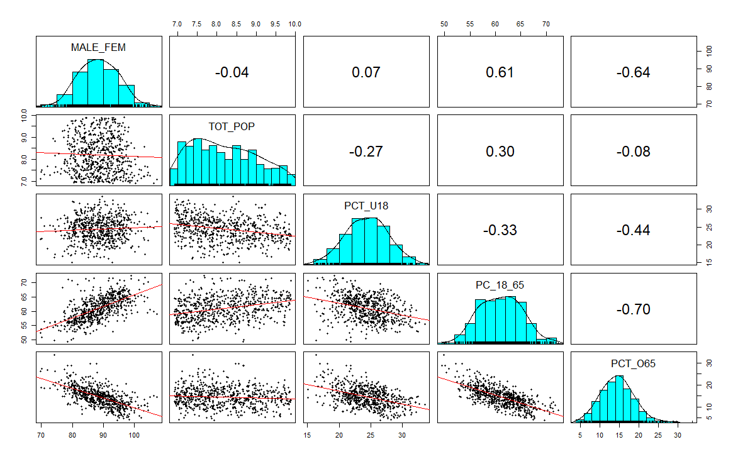
Combination of Scatterplot Matrix, Histograms, Correlation Matrix after Data Cleaning
Notes:
After cleaning the dataset which was the most challenging and time consuming for us, we got the following charts.
How did you clean the data?
Well, our data had a lot of outliers to deal with, but since we knew the data which we were considering as outliers was actually correct we
Did could not just simply drop off the outliers. First we tried to build the model using all the datapoints but our accuracy was only around 14%.
Then we tried to remove some more outliers, but still our accuracy was not increasing much.

Slide 20
Why
Multiple Regression ?
Notes:
Why did we apply Multiple Regression??
Why not others?
1. Since we were given the dependent variable therefore we had to Supervised Learning Algorithm.
2. Dependent Variable as Continuous.
3. There were multiple attributes present.

Slide 21
Assumptions Regarding Multiple Regression

Slide 22
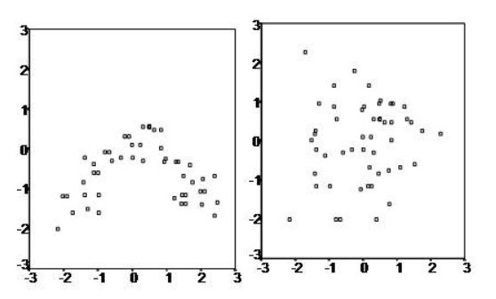
Assumptions Regarding Multiple Regression
LINEAR RELATION between the independent and dependent variables.
Notes:
When the scatter plot is something like the right one, we can use Multiple Regression.
And as we saw in (go to slide 19) these plots the scatterplots are showing Linear Relationship.

Slide 23
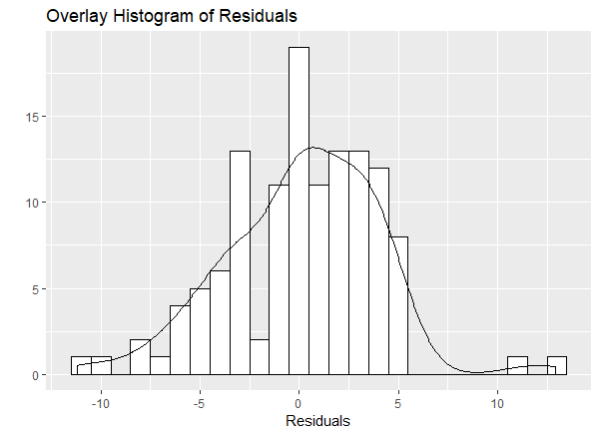
Assumptions Regarding Multiple Regression
LINEAR RELATION between the independent and dependent variables.
Multivariate Normality
Notes:
It means that the residuals are normally distributed.
What is Normal Distribution??
It is a bell shaped probability distribution curve that is symmetric about the mean,
showing that data near the mean are more frequent in occurrence than data far from the mean.

Slide 24
Assumptions Regarding Multiple Regression
LINEAR RELATION between the independent and dependent variables.
Multivariate Normality
No Multicollinearity
Notes:
The third assumption says that there should be no multicollinearity in the dataset.
But as we saw that the two variables in our data were highly multicollinear.
So we had to remove one of them.
So we built different models and then based on the accuracy of those models we removed the model consisting PCT_O65 as it was giving less accuracy.

Slide 25
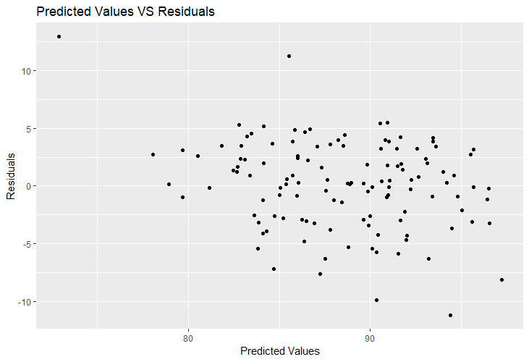
Assumptions Regarding Multiple Regression
LINEAR RELATION between the independent and dependent variables.
Multivariate Normality
No Multicollinearity
Homoscedasticity
Notes:
Homoscedasticity: According to this when a scatterplot of residuals vs predicted values is made
there should be no clear pattern in the distribution.
So clearly there is no clear pattern in this scatterplot.
Hence we satisfied all the assumptions related to the Multiple Regression.

Slide 26
Model Building
&
Evaluation
Notes:
After splitting the Dataset into Training and Testing, we trained our model using multiple regression.
We used the Backward Elimination process for building our model.
And this was the best model that we could come up with ->(Next Slide)
What is Backward Elimination?
On what basis did you remove the variables in Backward Selection ?
Is there any difference in results of Forward Selection and Backward Selection ?

Slide 27
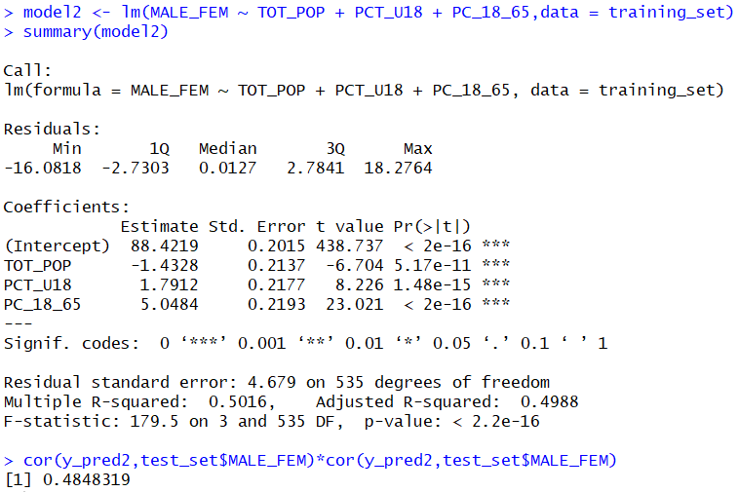
Notes:
….
….
The F-test for overall significance has the following two hypotheses:
The null hypothesis states that the model in which there are no independent variables fits the data.
The alternative hypothesis says that your model fits the data better than the intercept-only model.
If H0 is rejected we have sufficient evidence to conclude that there is a significant relationship between y and the independent variables.
If H0 is not we do not have sufficient evidence to conclude that there …
Since our p value for F statistic is very less than the level of significance therefore we reject the NULL hypothesis
And hence we can say that the value of R square is statistically significant and our model fits the data better than the intercept only model.

Slide 28
QUESTIONS
Build a regression with "MALE_FEM" as the response and all other variables as the predictors. Explain why the predictor "PCT_o65" is excluded in the model.

Slide 29
QUESTIONS
Build a regression with "MALE_FEM" as the response and all other variables as the predictors. Explain why the predictor "PCT_o65" is excluded in the model.
What is your conclusion regarding the significance of the overall regression?
Notes:
The F-statistic is used give the significance of the Overall Regression.
If the p value of F statistic is less than the level of significance i.e. 0.05 we reject the null hypothesis
and we have sufficient evidence to conclude that there is a significant relationship between the dependent variable y and the independent variables.
Null Hypothesis: The model (intercept only model) with no independent variables fits the data.
Alternative Hypothesis: This model fits the data better than the intercept only method.

Slide 30
QUESTIONS
Build a regression with "MALE_FEM" as the response and all other variables as the predictors. Explain why the predictor "PCT_o65" is excluded in the model.
What is your conclusion regarding the significance of the overall regression?
What is the typical error in prediction in the model?
The Residual Standard Error is 4.679 with Error Rate of 5.29%.
Notes:
The residual standard error (RSE) gives a measure of error of prediction:
The lower the RSE the more accurate the model:
The error rate can be calculated by dividing the RSE by mean(dependent variable) i.e.
Error Rate = RSE/mean(training_set$MALE_FEM)

Slide 31

QUESTIONS
Build a regression with "MALE_FEM" as the response and all other variables as the predictors. Explain why the predictor "PCT_o65" is excluded in the model.
What is your conclusion regarding the significance of the overall regression?
What is the typical error in prediction in the model?
How many towns are included in the sample?

Slide 32
QUESTIONS
Build a regression with "MALE_FEM" as the response and all other variables as the predictors. Explain why the predictor "PCT_o65" is excluded in the model.
What is your conclusion regarding the significance of the overall regression?
What is the typical error in prediction in the model?
How many towns are included in the sample?
Which of the predictors probably do/does not belong to the model? Explain how you know this. What might be your next step after viewing this results?
Notes:
PCT_065 did not belong in this model
Because as there was multicollinearity in our model we had to remove one of the two variables.
No because we were getting better accuracy without using this variable we excluded it.

Slide 33
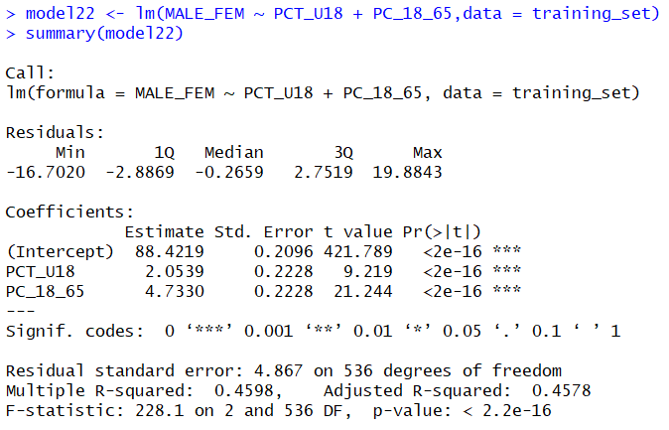
QUESTIONS
Suppose you omit the predictor "TOT_POP" from the model and rerun the regression. Explain what will happen to the value of R-square.

Slide 34


Discuss the presence of multicollinearity. Evaluate the strength of evidence for the presence of multicollinearity. On the basis of this, should you turn to Principal Component Analysis?
Notes:
PC_18_65 is multicollinear
First we made a model using all the variables.
There is a very simple test to assess multicollinearity in your regression model.
The variance inflation factor (VIF) identifies correlation between independent variables and the strength of that correlation.
The value of VIF starts at 1 and has no upper limit.
Value of 1 indicates that there is no correlation between this independent variables and others.
So here we can see the value of VIF in case of PCT_O65 is the highest.
So we simply removed this variable.
No, there is no need to turn to Principal Component Analysis as the number of features are very less.

Slide 35
QUESTIONS
Clearly and completely express the interpretation for the coefficients for PCT_u18. Discuss whether this makes sense.
Notes:
8. If we increase the value of PCT_U18 by 1, then what will be the change in the value of response variable when all others are kept constant.

Slide 36
Conclusions:
Notes:
So again after listening the accuracy many you might be thinking that our model is not good.
But trust me we applied a whole lot of things to improve our accuracy.
So let me again bring you back to my previous question that just by knowing your age group how can I tell whether you’re a male or female
So maybe the variables from which we had to predict the Male to Female ratio were not enough to predict the male to female ratio.

Slide 37
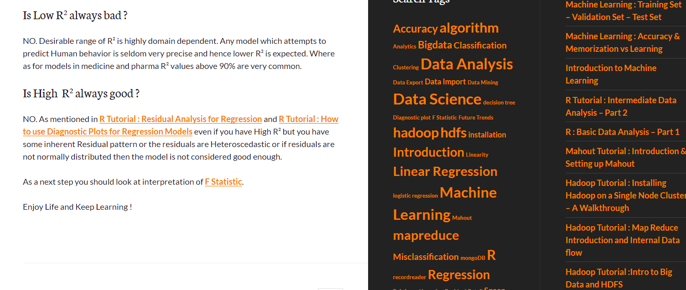
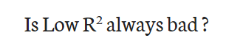
Notes:
Moreover when researching about the same
NO. Desiable range of R2 is highly domain dependent.
Any model which attempts to predict Human Behaviour is seldom very precise and hence lower R square is expected.
Where as for models in medicine and pharma R2 values above 90% are very common.

Slide 38
THANK YOU

